Slide 1
How much do particular home improvements increase the resale value of your home?
By: Jordan Gates

Slide 2
There are an almost endless number of home improvements that people make on their homes for various reasons. But how do these "improvements" affect the resale value of their house?
Will a roof of a different material actually increase the resale value? And if so, by how much?
What about other renovations and improvements?
If your goal is to increase the value of you home, are these improvements worth the cost?
I created a machine learning model that analyzes data from thousands of homes sold between 2006 and 2010 in order to create reliable predictions on the value of various homes. We can use this model to create predictions on the value of a home both with and without a particular improvement, compare the difference in value, and determine whether or not that home improvement will actually improve the value of that home.

Slide 3
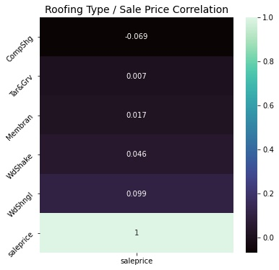
Don’t waste your money! Which home “improvements” don’t actually increase the value of your home?
Let’s take half bathrooms as an example.
When my model analyzed the impact of the number of half bathrooms in a home, the predictions showed that adding a half bathroom would have negligible impact on resale value.
Another common example could be roofing. Here we can see that the correlation between Sale Price and Roof Type have nearly no correlation.

Slide 4
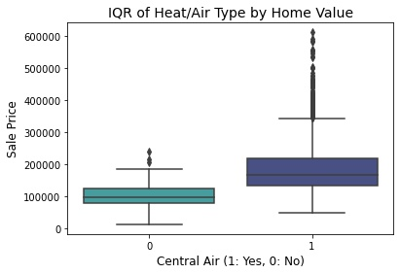
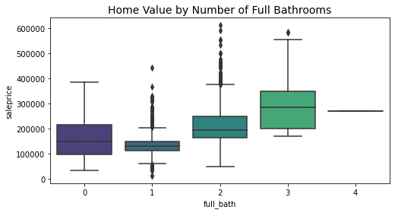
Which home improvements can actually increase to value of your home?
In these barplots we can see that homes with certain features tend to sell for higher prices, but by using our model, we can actually make predictions on what the value increase would be.
By making predictions on the same houses with their original number of full bathrooms, and with one full bath added, we can quantify and expected increase in home value by having an additional full bathroom installed. In this case, our model predicted that adding a full bath would increase home value by 3%

Slide 5
Conclusion
By using this predictive model we can make predictions about how a certain home improvement project may or may not improve the value of a home.
+ 1 Basement Full Bath: 6% increase in value
+ 1 Full Bath: 3% increase in value
+ 1 Half bath: Negligible increase in value
We previously used the mean of several homes with and without a particular feature, but we can also input our own custom data about our own home, and get an estimated value with and without the home improvement that is in question.

